Slide 1


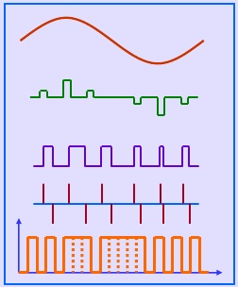
ANALOG AND PULSE MODULATION
SRI KRISHNA COLLEGE OF ENGINEERING AND TECHNOLOGY

Slide 2
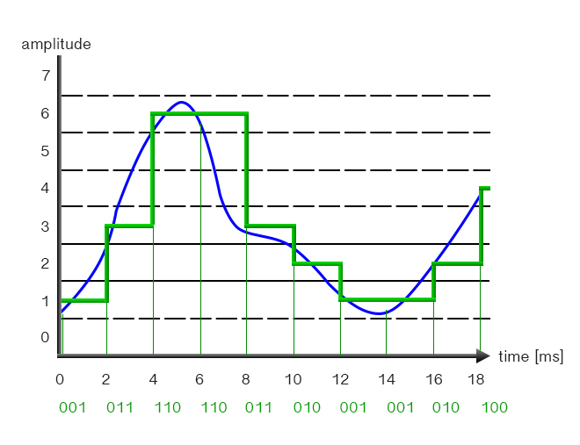

Slide 3
Pulse Code Modulation
In pulse code modulation (PCM), a message signal is represented by a sequence of coded pulses, which is accomplished by representing the signal in discrete form in both time and amplitude.
The basic operations performed in the transmitter of a PCM system are sampling, quantization, and encoding.
The low-pass filter prior to sampling is included merely to prevent aliasing of the message signal.
The quantizing and encoding operations are usually performed in the same circuit, which is called an analog-to-digital converter.

Slide 4
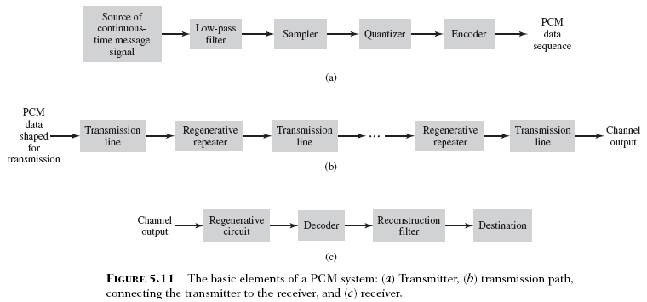
Pulse Code Modulation System

Slide 5
Operations - Sampling
The incoming message (baseband) signal is sampled with a train of rectangular pulses, narrow enough to closely approximate the instantaneous sampling process.
The sampling rate must be in accordance with the sampling theorem.
In practice, an anti-alias (low-pass) filter is used at the front end of the sampler in order to exclude frequencies greater than W before sampling.
Thus the application of sampling permits the reduction of the continuously varying message signal (of some finite duration) to a limited number of discrete values per second.

Slide 6
Operations - Non-uniform Quantization
The sampled version of the message signal is then quantized, thereby providing a new representation of the signal that is discrete in both time and amplitude.
In certain applications, however, it is preferable to use a variable separation between the representation levels.
By using a non-uniform quantizer with the feature that the step size increases as the separation from the origin of the input–output amplitude characteristic is increased, the large end-step of the quantizer can take care of possible excursions of the voice signal into the large amplitude ranges that occur relatively infrequently.

Slide 7
Operations - Encoding
In combining the processes of sampling and quantization, the specification of a continuous message (baseband) signal becomes limited to a discrete set of values, but not in the form best suited to transmission over a wire line or radio path.
To exploit the advantages of sampling and quantization for the purpose of making the transmitted signal more robust to noise, interference and other channel degradations, the use of an encoding process is required to translate the discrete set of sample values to a more appropriate form of signal.

Slide 8
Operations - Encoding
Any plan for representing this discrete set of values as a particular arrangement of discrete events is called a code.
One of the discrete events in a code is called a code element or symbol.
For example, the presence or absence of a pulse is a symbol.
A particular arrangement of symbols used in a code to represent a single value of the discrete set is called a code word or character.

Slide 9
Binary codes
In practice, a binary code is preferred over other codes (e.g., ternary code) for two reasons:
1. The maximum advantage over the effects of noise in a transmission medium is obtained by using a binary code, because a binary symbol withstands a relatively high level of noise.
2. The binary code is easy to generate and regenerate.

Slide 10
Distortion
The most important feature of a PCM system lies in the ability to control the effects of distortion and noise produced by transmitting a PCM signal over a channel.
This capability is accomplished by reconstructing the PCM signal by means of a chain of regenerative repeaters located at sufficiently close spacing along the transmission route.

Slide 11
Differential PCM
Often voice and video signals do not change much from one sample to next. - Such signals has energy concentrated in lower frequency. - Sampling faster than necessary generates redundant information. Can save bandwidth by not sending all samples. * Send true samples occasionally. * In between, send only change from previous value. * Change values can be sent using a fewer number of bits than true samples.

Slide 12
DPCM
Differential pulse code modulation is a derivative of the standard PCM
It uses the fact that the range of differences in amplitudes between successive samples of the audio waveform is less than the range of the actual sample amplitudes
Hence fewer bits to represent the difference signals

Slide 13
Prediction
A redundant signal helps to infer the rest, or at least make the most probable estimate.
If past behavior of a signal up to a certain point in time is known, it is possible to make some inference about its future values; such a process is commonly called prediction.
Suppose then a message signal is sampled at the rate to produce a sequence of correlated samples seconds apart; this sequence is denoted by The fact that it is possible to predict future values of the signal provides motivation for the differential quantization scheme.

Slide 14
Transmitter
In this scheme, the input signal to the quantizer is defined by
The input is m and prediction is m(cap).
This predicted value is produced by using a prediction filter whose input consists of a quantized version of m(nT_{s}).
The difference signal e(nT_{s}) is called the prediction error, since it is the amount by which the prediction filter fails to predict the incoming message signal exactly.
The effective approach to implement the prediction filter is to use a tapped-delay-line filter or discrete-time filter.

Slide 15
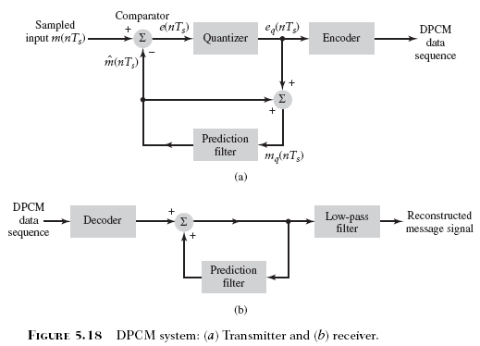
DPCM system

Slide 16
DPCM System
The signal m_{q}(nT_{s}) is quantized version of the message sample m(nT_{s}).
If the prediction is good, the average power of the prediction error will be smaller than the average power of so that a quantizer with a given number of levels can be adjusted to produce a quantization error with a smaller average power than would be possible if were quantized directly using PCM.

Slide 17
Receiver
It consists of a decoder to reconstruct the quantized error signal.
The quantized version of the original input is reconstructed from the decoder output using the same prediction filter in the transmitter.
In the absence of channel noise, the encoded signal at the receiver input is identical to the encoded signal at the transmitter output.
An estimate of the original message signal m(t) is obtained by passing the sequence m_{q}(nT_{s}) through a low-pass reconstruction filter.
In a noise-free environment, the prediction filters in the transmitter and receiver operate on the same sequence of samples {m_{q}(nT_{s})}.

Slide 18
PCM vs DPCM
PCM | DPCM
In PCM, feedback is not provided. | While in DPCM, feedback is provided.
It has good signal to noise ration. | While it has moderate signal to noise ratio.
It is less efficient than DPCM. | While it is more efficient than PCM.
For transmission channel, PCM needs high bandwidth(B). | Whereas DPCM needs less bandwidth(B) than PCM.
PCM is complex than DPCM in terms of complexity. | While DPCM is simple in terms of complexity.
In PCM, seven bits are transmitted per eight sample. | In DPCM, four bits are transmitted per six sample.
In PCM, for transmitting bits rate varies from fifty five to sixty four. | While in DPCM, for transmitting bits rate varies from thirty two to forty eight.

Slide 19


